Slide 1
Next Generation Sequencing (NGS) and its platforms
Phuc-Loi Luu, PhD
Luu.p.loi@googlemail.com
loi.lp@pacificinformatics.com.vn
23.04.2023

Slide 2
Agenda 23 April 2023
Time | Content | Presenter
19:00-19:15 | From microarray to sequencing technology | Loi
19:15-19:30 | Sanger sequencing | Phuoc (Sisc group)
19:30-20:00 | Illumina platform | Huong (Biomedic JSC)
20:00-20:30 | MGI platform | Van (Research Instruments)
20:30-21:00 | Ion Torrent platform | Phuoc (Sisc group)
21:00-21:30 | Bioinformatics analysis of NGS | Loi
21:30-22:00 | Discussion | All

Slide 3
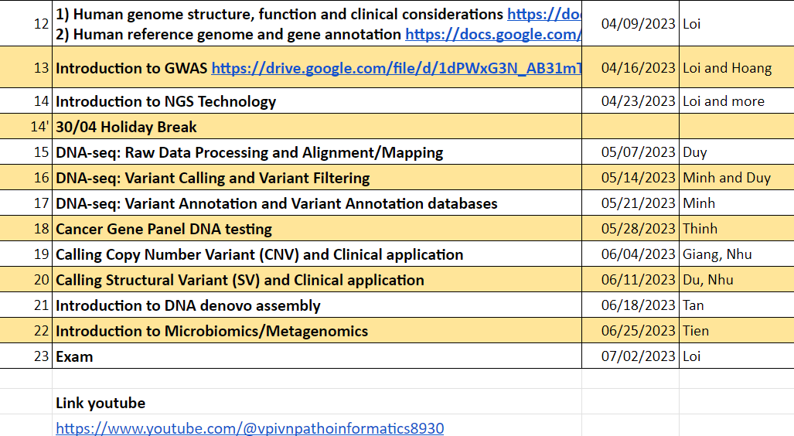
Module II: DNA-seq
Short read
Long read:
Pacbio
Oxford NanoPore

Slide 4
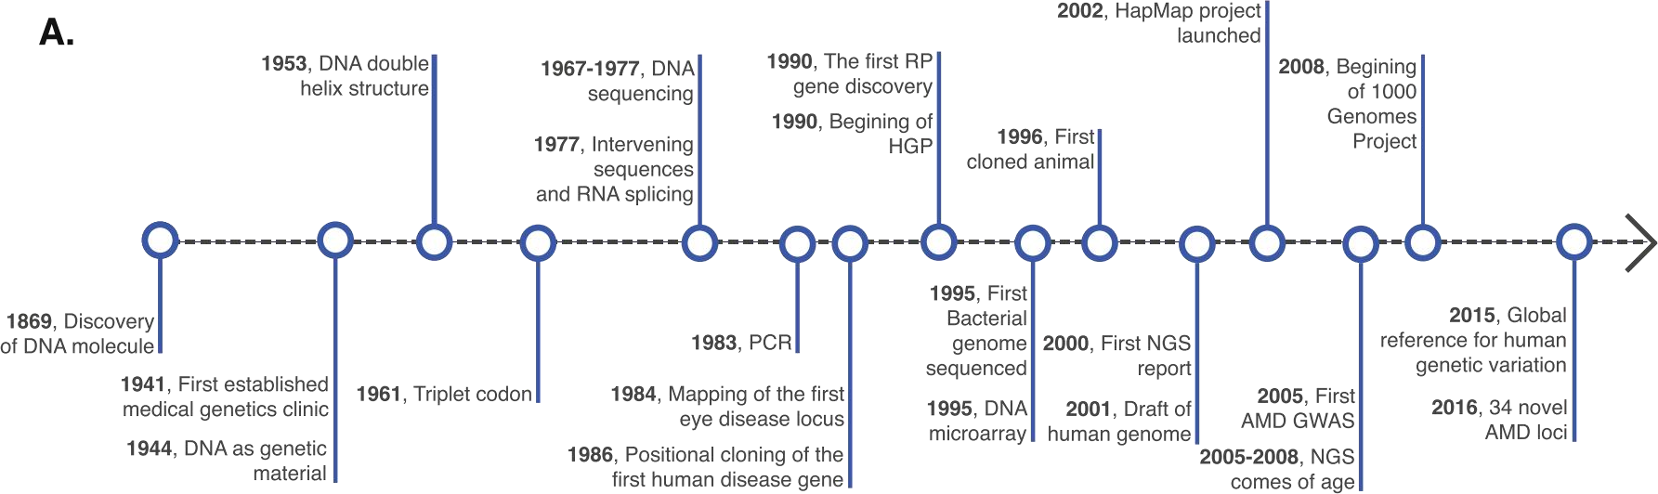
Timeline of human genetics and genomic technologies
Age-related macular degeneration (AMD)
Human Genome Project (HGP)
http://dx.doi.org/10.1016/j.preteyeres.2016.06.001
From genotyping with DNA Microarray to SNP discovery with High Throughput Sequencing

Slide 5
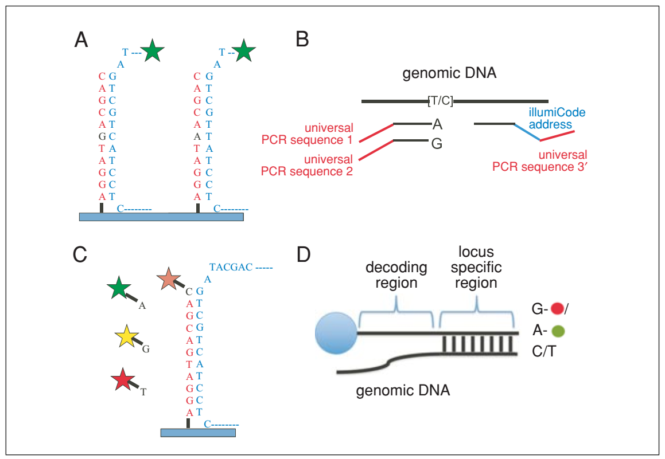
DNA Microarray (dChip)
Figure 22.1.4 SNP detection strategies for arrays.
(A) Allele discrimination by hybridization. Oligos that are complementary to each allele are placed on the array and labeled genomic DNA is hybridized to the array. The variant position is placed in the center of the oligo (typically 25 bp on Affymetrix arrays), as this position has the greatest effect on hybridization. Typically, multiple array positions are used for each allele to improve signal-to-noise.
(B) Illumina’s “Golden Gate Assay.” Two allele-specific oligos are each tailed with a different universal primer (1 and 2) and hybridized in solution to genomic DNA. A third oligo that is complementary to the same locus is tailed with a “barcode” sequence and a third universal primer (3). Polymerase is used to extend the allele-specific primers across the genomic sequence, and the extended products are ligated to the third oligo. PCR is performed using primers complementary to universal sequences 1, 2, and 3. The PCR primers complementary to the universal sequences 1 and 2 are labeled with a unique fluorophore. The barcode sequence on the third oligo allows the PCR product to be uniquely detected on an array containing oligos complementary to the barcode sequence. The use of multiple barcodes (one for each locus of interest) allows the assay to be multiplexed to sample many loci.
(C) Arrayed primer extension (APEX). In this assay, the array contains DNA oriented with the 5_x0003_ end attached to the array and the 3_x0003_ end stopping one nucleotide short of the SNP. Genomic DNA is fragmented and hybridized to the array, and the oligo on the array is extended in a single nucleotide dye terminator sequencing reaction.
(D) Illumina’s Infinium assay. This assay is similar to the APEX assay except that the oligo to be extended is on a bead and the single nucleotide that is added is labeled with a nucleotide-specific hapten as opposed to a fluorophore. The haptens are then detected by staining with fluorescently labeled proteins that bind each hapten.
DOI: 10.1002/0471142727.mb2201s101

Slide 6
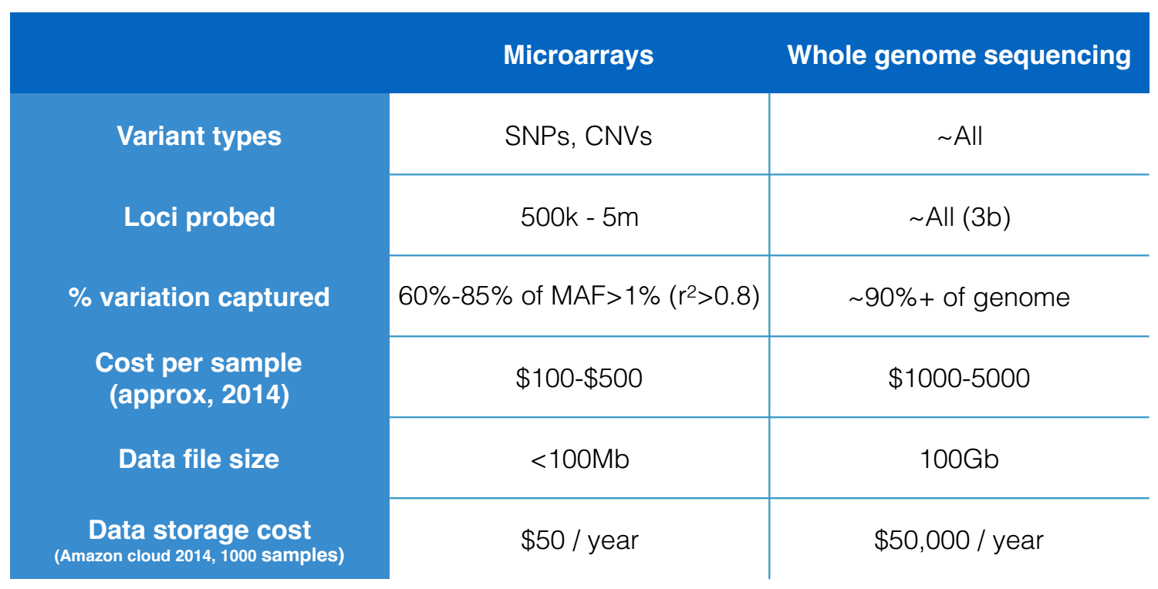
Experiment design

Slide 7
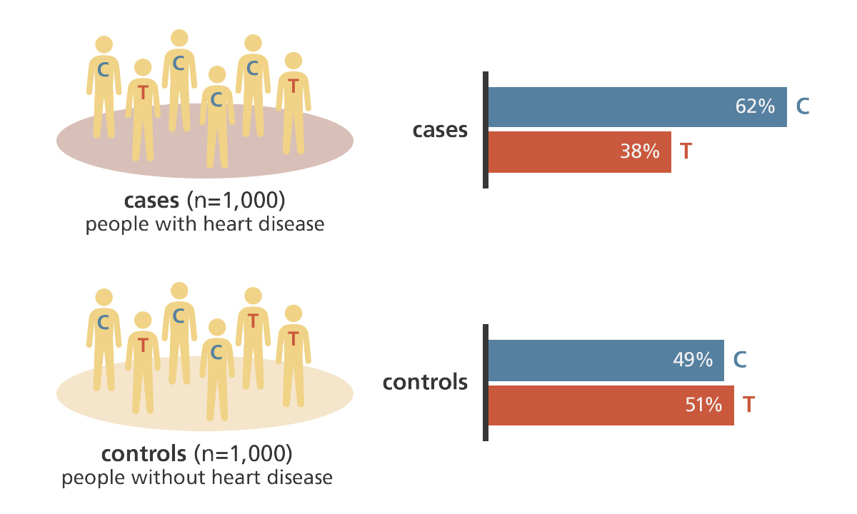
Example of heart disease
https://www.yourgenome.org/stories/genome-wide-association-studies

Slide 8
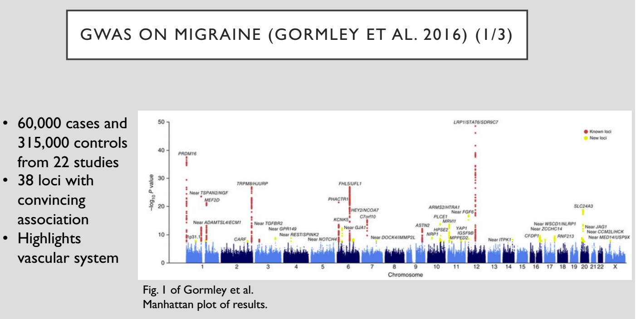

Slide 9
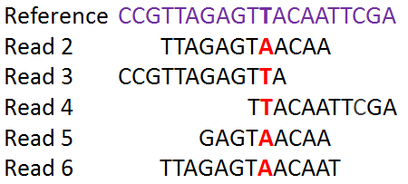
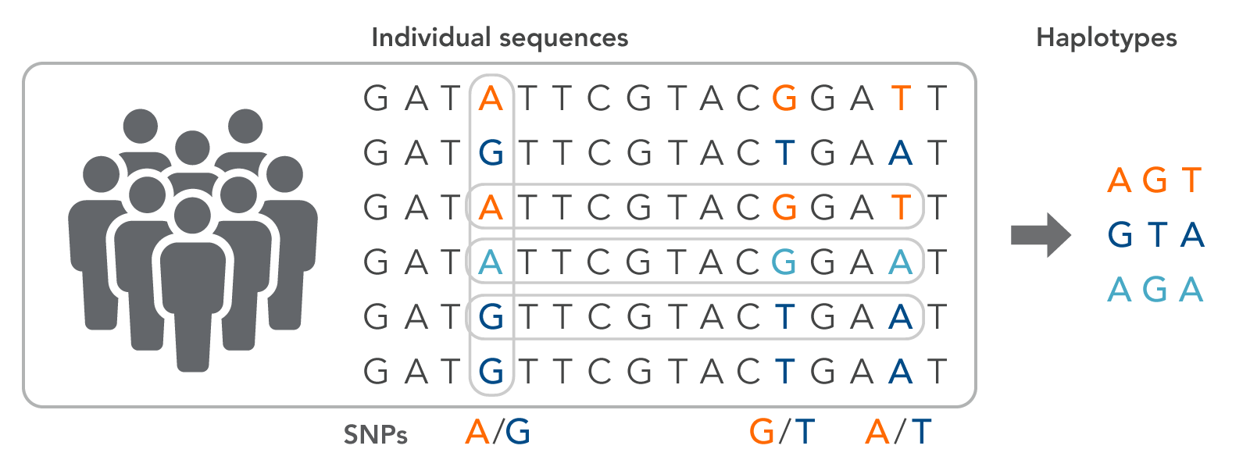
Whole genome sequencing (WGS), Whole Exome Sequencing (WES) and Target Sequencing with NGS
One individual
Multi individual
https://online.stat.psu.edu/stat555/node/106/

Slide 10
Four Fundamentally Different Approaches to DNA Sequencing
Chemical degradation of DNA
Maxam-Gilbert
Obsolete
Sequencing by synthesis (“SBS”)
Uses DNA polymerase in a primer extension reaction
Most common approach
Fred Sanger developed it (“Sanger sequencing”)
Illumina, Pacific Biosciences (being bought by Illumina), Ion Torrent, 454
Ligation-based
Sequencing using short probes that hybridize to the template
SOLiD, BGI-Seq (Complete Genomics)
Nanopore
Inferring sequence by change in electrical current as ssDNA is pulled though a nanopore
Oxford Nanopore, NABsys, Genia

Slide 11
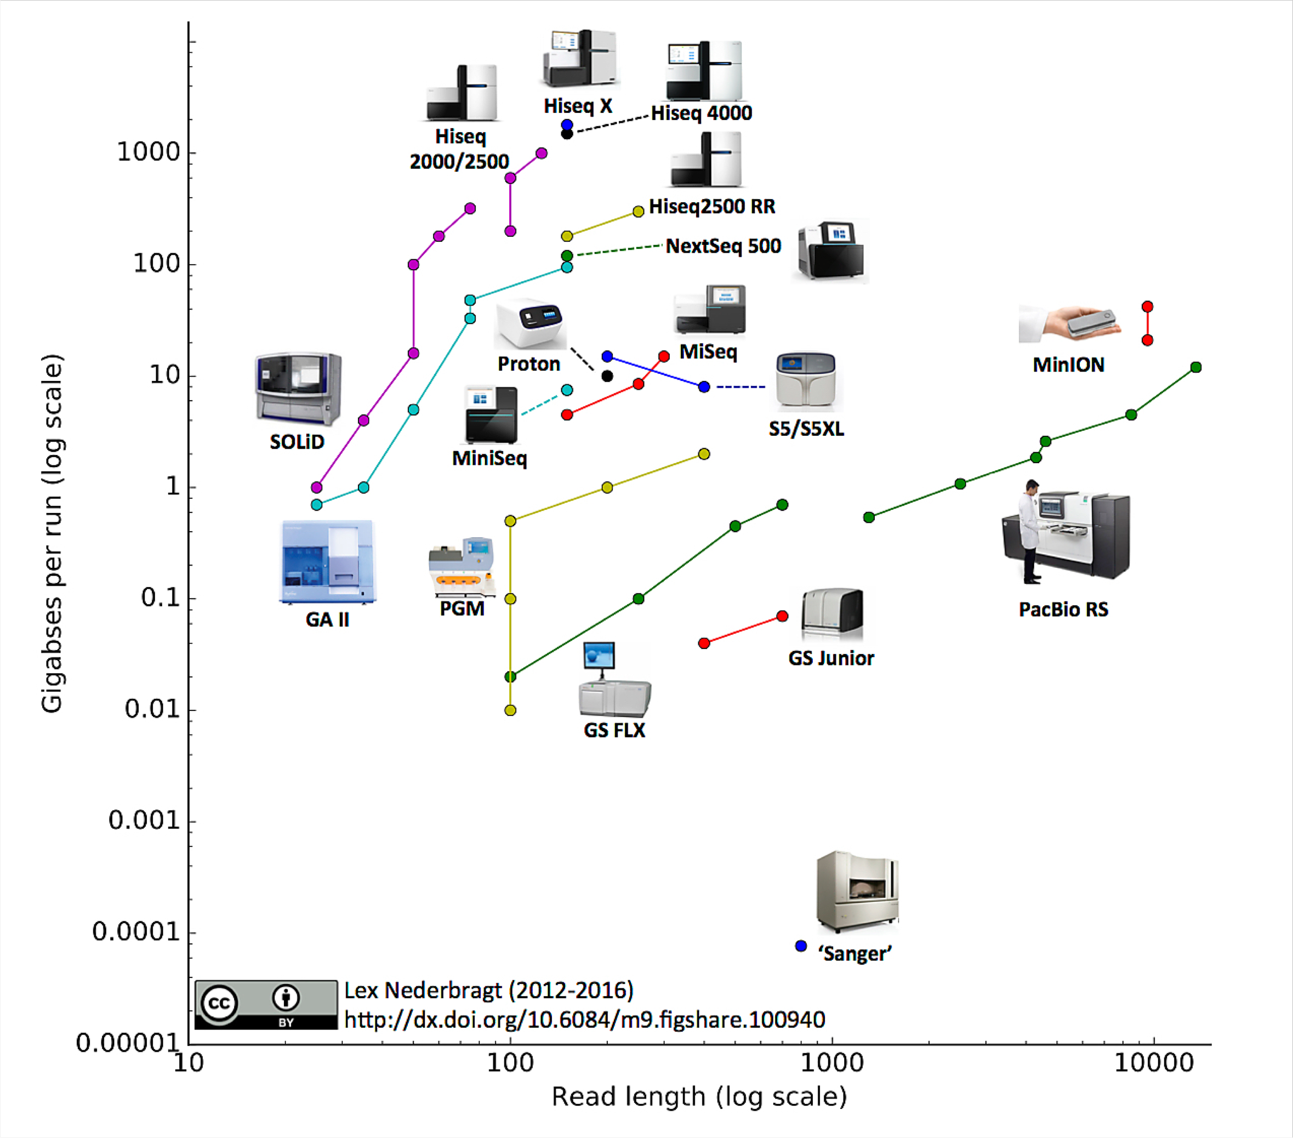
Throughput and Read Length in Sequencing

Slide 12


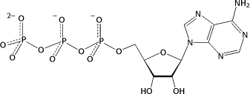
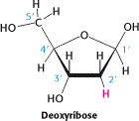
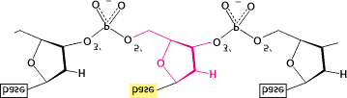
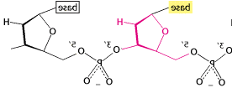
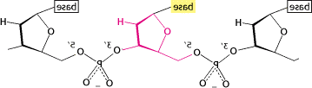
5’ and 3’
Base plus sugar
“nucleoside”
Adenine Adenosine
Guanine Guanosine
Cytosine Cytidine
Thymine Thymidine
in DNA: “deoxyadenosine”
plus triphosphate “deoxynucleotide”
“2’-deoxyadenosine 5’-
triphosphate” = dATP
5’
3’
Deoxyribose
PO₃
5’
P
3’
P
3’
3’ _{OH}
5’
5’
base
base
base
base
base
base
base
base
5’
3’
5’
3’
5’
3’
5’
3’
Antiparallel
OH
3’
3
P
P
P
P
5’
PO
If I throw in DNA polymerase and free nucleotide, which end gets extended?
Adapted From Berg et al: Biochemistry 5th ed. Freeman+Co, 2002

Slide 13
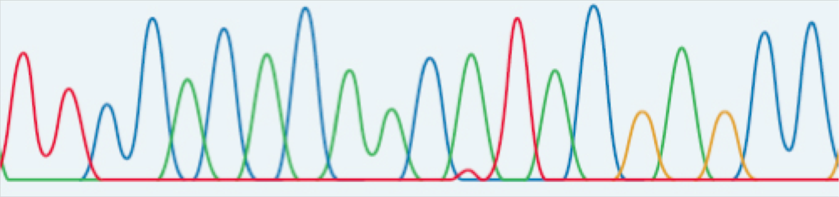
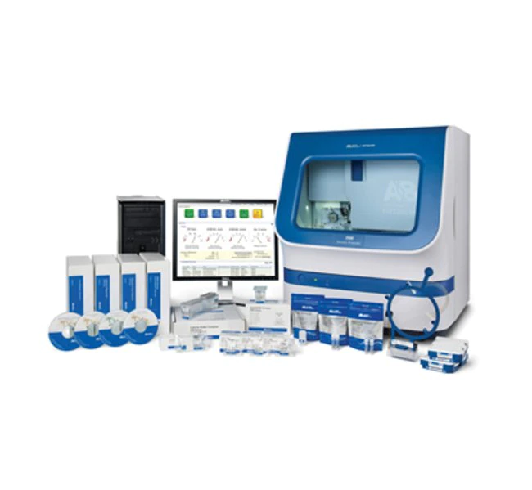
Fluorescent Sanger Sequencing Trace
Lane signal
(Real fluorescent signals from a lane/capillary are much uglier than this).
Various algorithms to boost signal/noise, correct for dye-effects, mobility differences, etc., generates the ‘final’ trace (for each capillary of the run)
Trace
Recombinant DNA: Genes and Genomes. 3rd Edition (Dec06). WH Freeman Press.

Slide 14
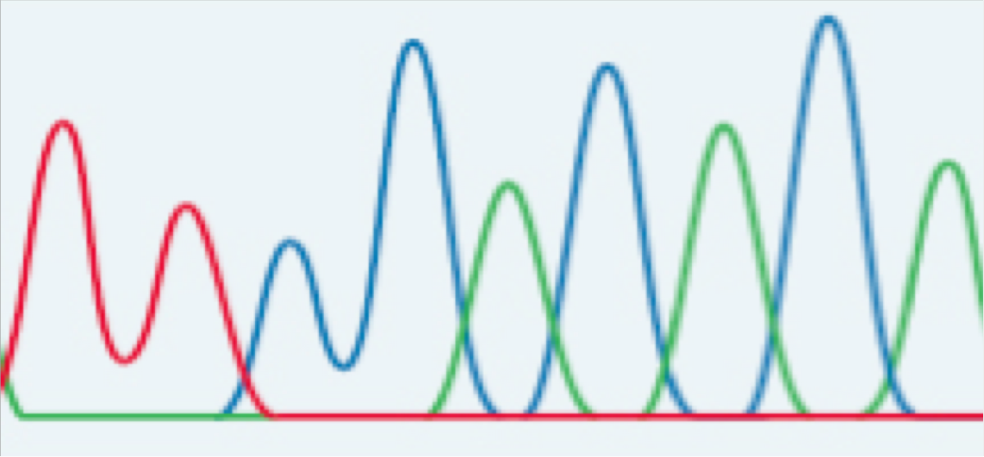
Sanger Base Calling
Low quality over here…
…low quality over there
Base Caller (Phred)
... 44 | 45 | 46 | 47 | 48 | 49 | 50 | 51 | 52 | 53 | 54 | 55 ... 718 | 719 | 720 | ...
... N | A | G | C | G | T | T | C | C | G | C | G ... A | N | N | ...
... 0 | 3 | 20 | 25 | 40 | 88 | 95 | 99 | 99 | 99 | 99 | 99 ... 10 | 0 | 0 | ...
Quality score = -10 * log(probability of error) or P=10^-Q/10 For Q20, probability of error = 1/100
For Q99, probability of error ~10⁻¹⁰

Slide 15
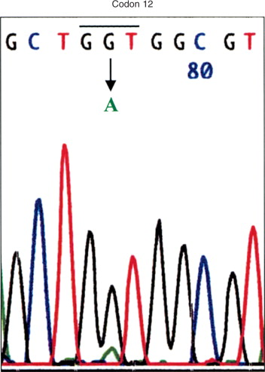
Sanger Base Calling

Slide 16
Phred: The base-calling program for ABI sequencing
Algorithm based on ideas about what might go wrong in a sequencing reaction and in electrophoresis
Tested the algorithm on a huge dataset of “gold standard” sequences (finished human and C. elegans sequences generated by highly-redundant sequencing)
Compared the results of phred with the ABI Basecaller
Phred was considerably more accurate (40-50% fewer errors), particularly for indels and particularly for the higher quality sequences
(Ewing et al., 1998, Genome Research 8: 175-185; Ewing and Green 1998, Genome Research 8: 186-194)

Slide 17
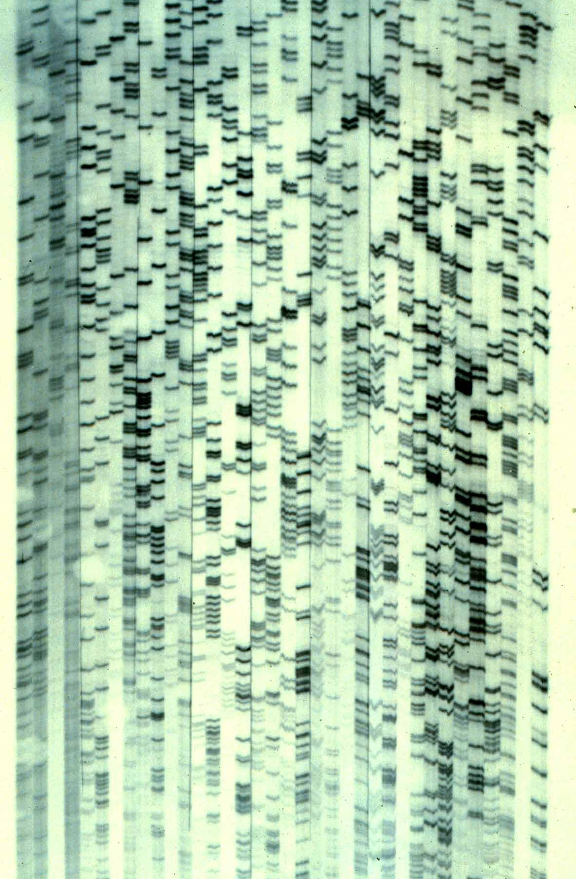
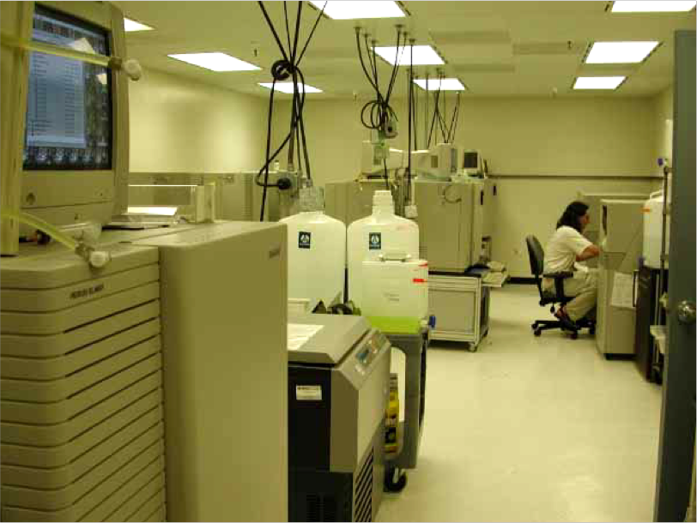
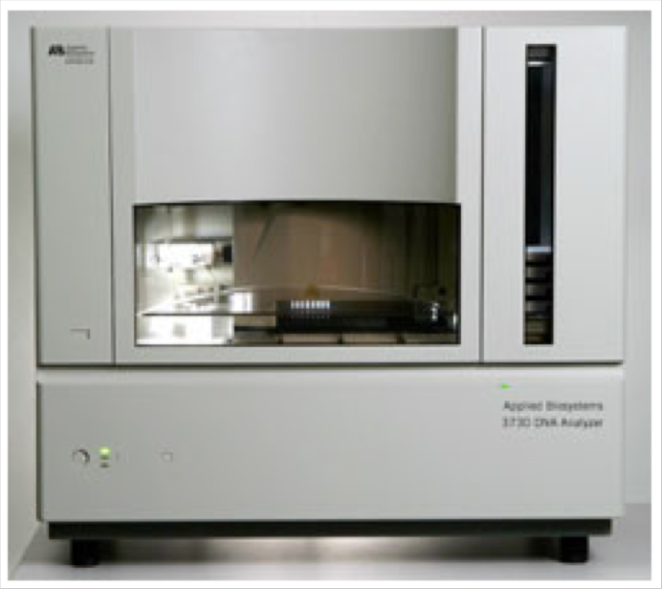


Progress of Sanger Sequencing Technology
Radioactive polyacrylamide slab gel
Low throughput, labor intensive
AB slab gel sequencers (370, 373, 377)
Fluorescent sequencing 1990-1999
6 runs/day
96 reads/run
500 bp/read
288,000 bp/day
AB capillary sequencers (3700, 3730)
1998-now 24 runs/day
96 reads/run
550 – 1,000 bp/read
1-2 million bp/day
~1,000-fold increase in throughput since 1985 accomplished by incremental improvements of the same underlying technology
2nd Generation Sequencing Technologies have >1e6x more throughput than 3730

Slide 18
Whole Genome Sequencing
Two main challenges:
Getting sufficient “coverage” of the genome
A function of read length, number of reads, complexity of library, and size of genome
Assembling the sequence reads into a complete genome
A function of coverage, and repeat size (relative to read lengths) and repeat frequency

Slide 19
Overcoming repeats
Most problematic when:
Repeats are longer than read lengths
Repeats are present in many copies
Recognize based on coverage
Resolve with longer range continuity information:
Paired-end reads
Multiple insert size libraries
Plasmids
Fosmids
BAC ends
Other tricks (which I’ll come to later)

Slide 20


Whole Genome Sequencing Approaches
Hierarchical Shotgun Approach
Genomic DNA
BAC library
(minimal tiling path)
Organized, Mapped Large
Clone Contigs
Shotgun Clones
GAAATATGTTCTTGTAATTTAAGCTGACACTCCTAATTTAGCTCTTGTCCTCTACTGAGTCTACCTAATTATATGTATGGATTGACTTGG
AGCTCTTGTCCTCTACTGAGTCTACCTAATTATATGTATGGATTGACTTGGTGTTTTCTCTTTTTCTTAAATAGTAATGCAGAAAGCCTGGAGAGAGAG
Reads
GAAATATGTTCTTGTAATTTAAGCTGACACTCCTAATTTAGCTCTTGTCCTCTACTGAGTCTACCTAATTATATGTATGGATTGACTTGGTGTTTTCTCTTTTTCTTAAATAGTAATGCAGAAAGCCTGGAGAGAGAG
^{Assembly}

Slide 21

Whole Genome Sequencing Approaches
Shotgun Approach
Genomic DNA
Shotgun Clones
GAAATATGTTCTTGTAATTTAAGCTGACACTCCTAATTTAGCTCTTGTCCTCTACTGAGTCTACCTAATTATATGTATGGATTGACTTGG
AGCTCTTGTCCTCTACTGAGTCTACCTAATTATATGTATGGATTGACTTGGTGTTTTCTCTTTTTCTTAAATAGTAATGCAGAAAGCCTGGAGAGAGAG
Reads
GAAATATGTTCTTGTAATTTAAGCTGACACTCCTAATTTAGCTCTTGTCCTCTACTGAGTCTACCTAATTATATGTATGGATTGACTTGGTGTTTTCTCTTTTTCTTAAATAGTAATGCAGAAAGCCTGGAGAGAGAG
^{Assembly}

Slide 22
Single End Read
GCAATGAAATATGTTCTTGTAATTTAAGCTGACACTCCTAATTTAGCTCTTGTCCTCTACTGAGTCTACCTAATTATATGTATG GATTGACTTGGTGTTTTCTCTTTTTCTTAAATAGTAATGCAGAAAGCCTGGAGAGAGAGAAACCCCCAAGCTAGGATTTCTGCA GCTCATGAAGCCTTGGAGATAAATGAGTAAGTGGGGGAAAATCTTGCTGTTAAAAAGGAAATCTCATCCTTTGCTGAATATATT CAGTTGCCATTGATAGGATACTTAAATTAAACTGCATTTGAACTGGAGGATTATTTGGGGAGTTATTACTCTATTTAAAAAAGT TTTTTTTTTAAATGAAGGACAGCCACCATGTGGAGGTGGTTTTAGTCATTTTATGAATTCAATGGCTTTGCTGTGATCCTAAAT TAATTTCTTGAAGGGCTATCCCTAGGATATTGTGAGGATATAAAATAAATACAATTCTTTACATATCTAAAACATTCTGACAGG GAAAATTTTCCAGATGTAGAATGCTCATCTGCACTAGAACATTTTCTAGTAGAACTTCTGCTAGTGGGGAAAACATGATAACAA CATAAGGTTTAAAAAAAAAATTTTAGAAAATACTTCAAGATTAAGACAAAGATAAGAGGAAATGCTGTCTTGAGTGTTGTTAAA CATTCTGTGGGTTACCAAGGAAGGCTGGGAAATCTCTTCTGGAGATCTCAGAAAATGAGAAAGATTCTTAAAGTTGGAGTCATA AAAACTCAGGGTTGGCAGAGACCTTAAAGGTCACTTAGCTGAACCACCCATCTGGTGCTTGAATCACCTCAACACTATCCTTGC CAAGTGGTCATTGTTAAACTATTTTATGATTTTTCTGAAGAAGGTTACAGAATCTTCTTCAGAGATCTTAGGGAAAAAAAAAAA AGATTGTCGTGAGAGTTGAAAATCCTGCCATTGTAACCAGTTGATCTACGGTTTCTGATTCTGTCATGCAACATATTTATTTTC CAGTTTCTTGTCATCTACAAATTCGATATGCCTGCCTTCTGTGTGTCATCCATATTTCTGAGAAAAATATGAAGGCCAGGAATA GAGCCCTGTGACATGACATAGAAACTACCCTCCAGGTTCATGTCTTCATGAATCACCATCTTTTGTATTGTTCACTCAATTACT AAGCCACCCAGTTACACTGTGACTCAGCTCATATTTCTCCATTTGGATCTTAAGAATGCCAATCGTAGCTGCGGATCTTAAATT TATAGTAAATCTATTACAGTAAATTAAGCTAGCACAATCTGATTTATTTATTCTTAGTGAATATAAGCTGGCTTCTAGTCGTCA CTACTTTCTTTTTAAAGTGCTTGGAGACCATTCCTTTAATAATCCATTAGAATATCTTTCCAAATCACTGTGTTCTGTAGTTTG GGAAGTCTGCCTTCTTCCCCTTTTTGAAAATTTATGCTACATTTATCATCTCATCTTCTAGCACCTCTCCATTCTTTGTGATTC CTCAACTATCCACAGAGAGCAATTCCATGGCCTGCCTACAAGGTCTTTCGGTTTCCTGGGATTTGCCCATCCAGTCCAGTAATT CATTTAGAATGGATCAATTATTTGCTATCTTACATCTTTTTACCCATTTTAGAGTTTAATTTCTTCTCCCTTTTTCAGTCTGAC AGTCATTCTCCTTGATAGAGAAGCCAGGAACAAAATAGGAGGGAGAGAGTTTTGCTTTTTCTTTATTATCTACTGCTTTTAACA ATAAACCTTCCTTGTTTTGATGTTATTATGTTGTTTGTCTTTTTTTTTTACTTATTTGCCTTTGTGACATGGGGACGGTGATAG GGCCTTAAATATAATTTTAAAATAGGGAATAAATGGTTGTCTTTAGTATTTTATTTTGTTTTATTATTATTATTATTATTGTTA TTTTTGCAAGCTTCAGCTAATTTGGAATTGTAGCTCTCCTGACATTATTCTTATAAGCTCATTCCACTCTCTTATAGACCATCA TTACATGCCCTCTTTCCATCTTTTAAAATATGTCCTTTAAAAATCTGACCTGGGAGAAATCTCTGTGAAGCCGTGTTGGTTACT TAAGTGCCACCCCTCTTTTCTTCCTGAGAGGATCATTTGTGATTGCAGTTACAGTTGA

Slide 23
Paired End Sequencing Reads
GCAATGAAATATGTTCTTGTAATTTAAGCTGACACTCCTAATTTAGCTCTTGTCCTCTACTGAGTCTACCTAATTATATGTAT GGATTGACTTGGTGTTTTCTCTTTTTCTTAAATAGTAATGCAGAAAGCCTGGAGAGAGAGAAACCCCCAAGCTAGGATTTCTG CAGCTCATGAAGCCTTGGAGATAAATGAGTAAGTGGGGGAAAATCTTGCTGTTAAAAAGGAAATCTCATCCTTTGCTGAATAT ATTCAGTTGCCATTGATAGGATACTTAAATTAAACTGCATTTGAACTGGAGGATTATTTGGGGAGTTATTACTCTATTTAAAA AAGTTTTTTTTTTAAATGAAGGACAGCCACCATGTGGAGGTGGTTTTAGTCATTTTATGAATTCAATGGCTTTGCTGTGATCC
................................................................................... TAAATTAATTTCTTGAAGGGCTATCCCTAGGATATTGTGAGGATATAAAATAAATACAATTCTTTACATATCTAAAACATTCT GACAGGGAAAATTTTCCAGATGTAGAATGCTCATCTGCACTAGAACATTTTCTAGTAGAACTTCTGCTAGTGGGGAAAACATG ATAACAACATAAGGTTTAAAAAAAAAATTTTAGAAAATACTTCAAGATTAAGACAAAGATAAGAGGAAATGCTGTCTTGAGTG TTGTTAAACATTCTGTGGGTTACCAAGGAAGGCTGGGAAATCTCTTCTGGAGATCTCAGAAAATGAGAAAGATTCTTAAAGTT GGAGTCATAAAAACTCAGGGTTGGCAGAGACCTTAAAGGTCACTTAGCTGAACCACCCATCTGGTGCTTGAATCACCTCAACA CTATCCTTGCCAAGTGGTCATTGTTAAACTATTTTATGATTTTTCTGAAGAAGGTTACAGAATCTTCTTCAGAGATCTTAGGG

Slide 24
Assembly: Contigs and Supercontigs
"Supercontig" or "Scaffold"
"Contig"
Seq gap
"Contig"
NNNNNN
number of N's in sequence = estimated size

Slide 25
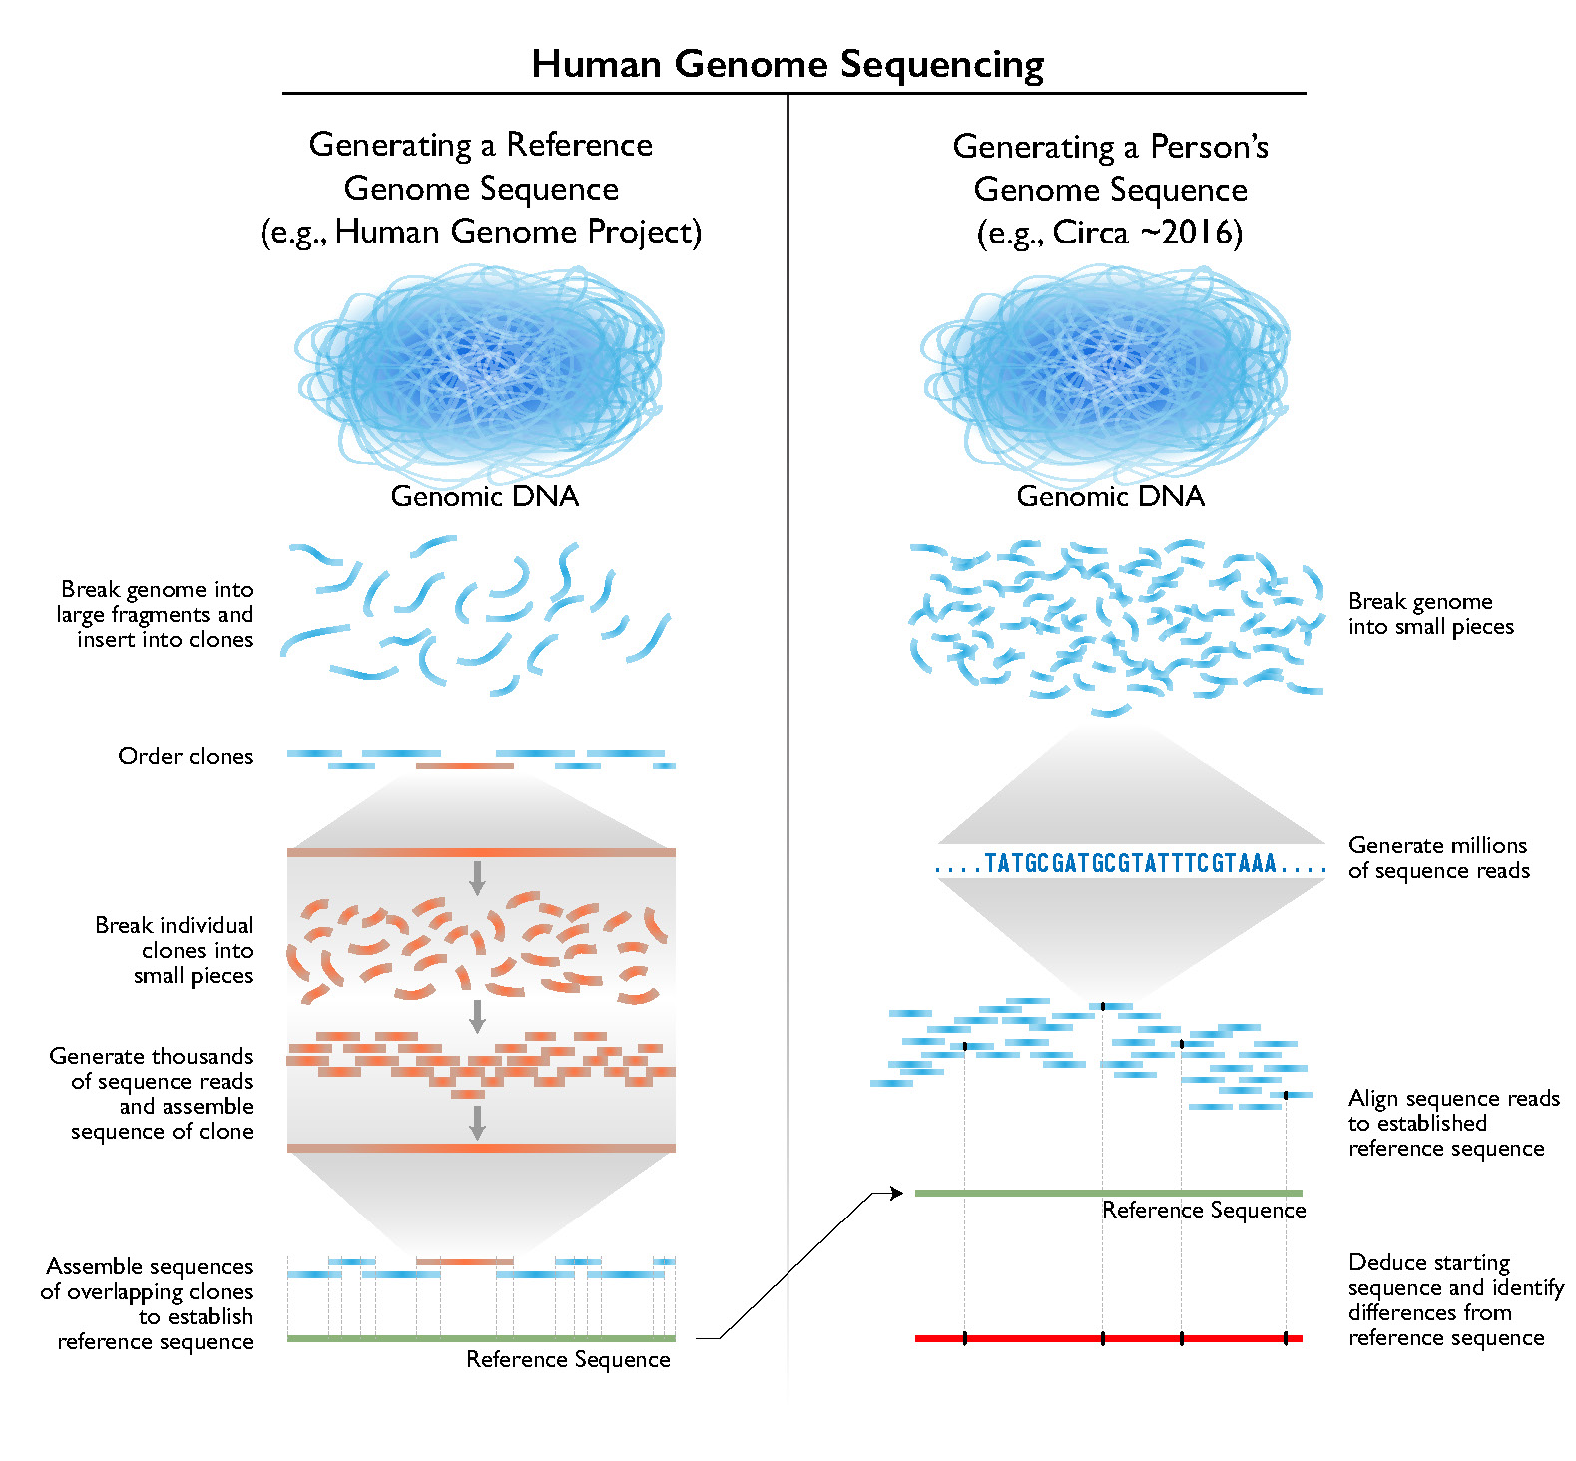
Human Genome Project: shotgun method
Once significant human genome sequencing began for the HGP, a 'draft' human genome sequence (as described above) was produced over a 15-month period (from April 1999 to June 2000). The estimated cost for generating that initial 'draft' human genome sequence is ~$300 million worldwide
https://www.genome.gov/about-genomics/fact-sheets/Sequencing-Human-Genome-cost

Slide 26
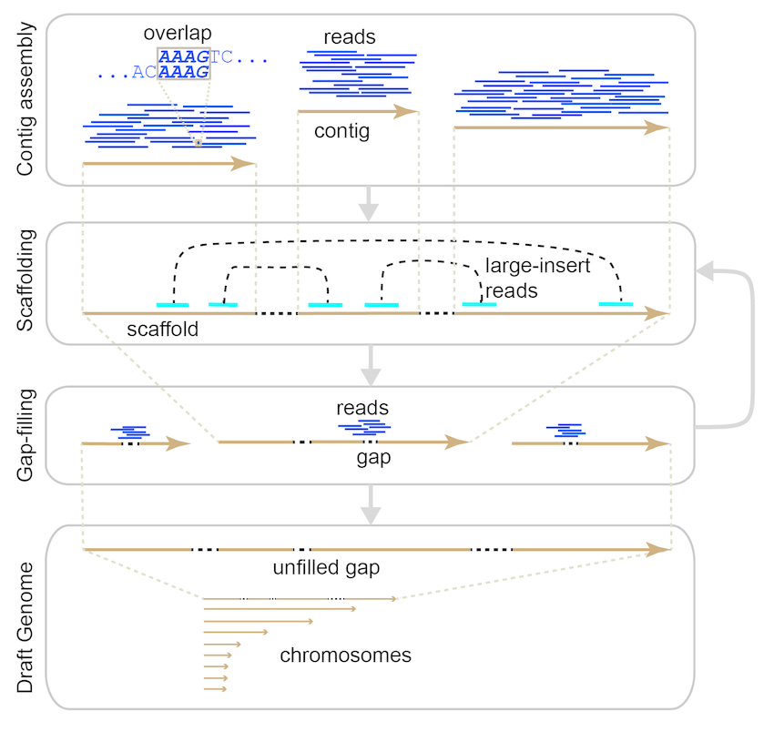
Assemblers
10.1093/BIB/BBW096

Slide 27
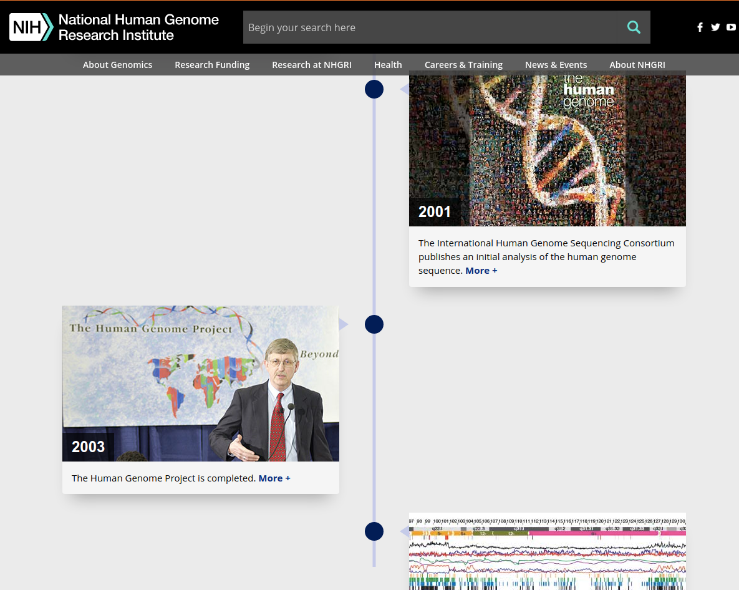
Human Genome Project: History
https://www.genome.gov/human-genome-project/Timeline-of-Events

Slide 28
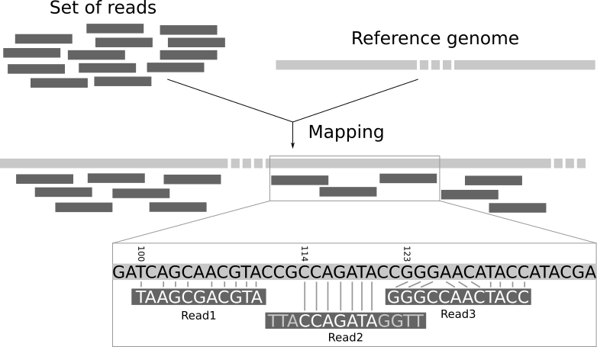
Mappers (Aligners)

Slide 29
High Throughput Sequencing
“The cost of DNA sequencing has plunged orders of magnitude in the last 25 years. Back in 1990, sequencing 1 million nucleotides cost the equivalent of 15 tons of gold (adjusted to 1990 price). At that time, this amount of material was equivalent to the output
of all United States gold mines combined over two weeks. Fastforwarding to the present, sequencing 1 million nucleotides is
equivalent to the value of ∼30 g of aluminum. This is approximately
the amount of material needed to wrap five breakfast sandwiches at a New York City food car.”
Erlich Y. (2015). A vision for ubiquitous sequencing. Genome Res. 25(10):1411-6.

Slide 30
The Players
Commercially available systems:
454, Helicos – both commercially dead
_{Illumina} – most prevalent technology
SOLiD (Life Technologies) - dead
Ion Torrent (Life Technologies)
Complete Genomics – acquired by BGI, now BGI-Seq
Pacific Biosciences – acquired by Illumina
Oxford Nanopore
Next generation approaches
Illumina Nanopore (probably abandoned)
NABsys, Genia, Noblegen – all be dead
Roswell Biotech – 4th generation? CMOS-based.

Slide 31
Sequencing Platforms
Platform | Reads x run: (M) | Read length: | Run time: (d) | Yield: (Gb) | Rate: (Gb/d) | per-Gb: ($) | hg-30x: ($) | Machine: ($)
iSeq 100 1fcell | 4 | 250* | 077-1.28 | 1.2-2 | 1.56 | 521 | $62,500 | 19.9K
MiniSeq 1fcell | 25 | 150* | 1 | 7.5 | 7.5 | 233 | $28,000 | 49.5K
MiSeq 1fcell | 25 | 300* | 2 | 15 | 7.5 | 66 | $8,000 | 99K
NextSeq 550 1fcell | 400 | 150* | 1.2 | 120 | 100 | 50 | $5,000 | 250K
HiSeq 2500 RR 2fcells | 600 | 100* | 1.125 | 120 | 106.6 | 51.2 | $6,144 | 740K
HiSeq 2500 V3 2fcells | 3000 | 100* | 11 | 600 | 55 | 39.1 | $4,692 | 690K
HiSeq 2500 V4 2fcells | 4000 | 125* | 6 | 1000 | 166 | 31.7 | $3,804 | 690K
HiSeq 4000 2fcells | 5000 | 150* | 3.5 | 1500 | 400 | 20.5 | $2,460 | 900K
HiSeq X 2fcells | 6000 | 150* | 3 | 1800 | 600 | 7.08 | $850 | 1M
NovaSeq S1 2fcells | 3300 | 150* | 1.66 | 1000 | 600 | 18.75 | $1,800 | 999K
NovaSeq S2 2fcells | 6600 | 150* | 1.66 | 2000 | 1200 | 17.5 | $1,564 | 999K
NovaSeq S4 2fcells | 20000 | 150* | 1.83 | 6000 | 3600 | 10.67 | $700 | 999K
Illumina PacBio RSII | 0.88 | 20K** | 4.3 | 12 | 2.8 | 200 | $24,000 | 695K
Illumina PacBio Sequel 16cells v6.0 2018 | 6.4 | 45K** | 6.6 | 160-320 | 24-48 | 80 | $9,600 | 350K
Illumina PacBio Q1 2019 | -- | 45K** | -- | 192 | -- | 6.6 | $1,000 | 350K
SmidgION 1fcell | -- | 500-2,000,000 | TBC | TBC | TBC | TBC | -- | --
Flongle 1fcell | -- | 500-2,000,000 | 1 | 0.1/1.8-3.3 | -- | 90-30 | $2,700 - $8,100 | --
MinION Mk 1B 1fcell | -- | 500-2,000,000 | 3 | 17/30-50 | -- | 50-12.5 | $1,125 - $2,700 | --
GridION X5 5fcells | -- | 500-2,000,000 | 3 | 85/150-250 | -- | 47.5/15.70-7 | $675 - $1,575 | --
PromethION 48fcells | -- | 500-2,000,000 | 2.6 | 3000/7000-15000 | -- | 14/7-3.5 | $315 - $1,400 | --
https://docs.google.com/spreadsheets/d/1GMMfhyLK0-q8XkIo3YxlWaZA5vVMuhU1kg41g4xLkXc/edit?hl=en_GB&hl=en_GB#gid=515231169

Slide 32
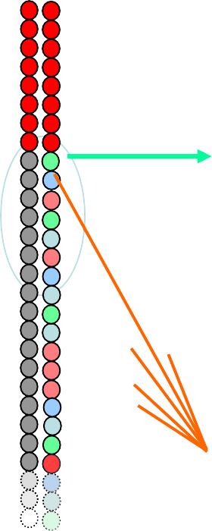


























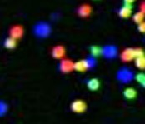

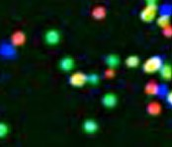
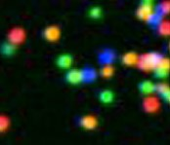

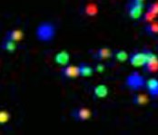
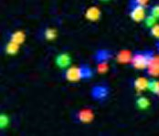
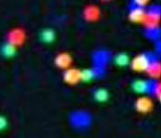


Illumina Sequencing Technology
Robust Reversible Terminator Chemistry Foundation
3’ 5’
DNA (0.1-1.0 ug)
^{A} G
C
T G C T A C G A T A C C C G A T C G A T
A
T
C
G
T
A
C
G
Sample preparation
T
Cluster growth
Single molecule array
5’
Sequencing
1
2
3
4
5
6
7
8
9
T G C T A C G A T
…
Image acquisition
Base calling

Slide 33
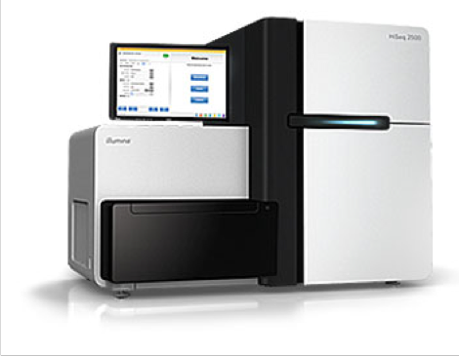

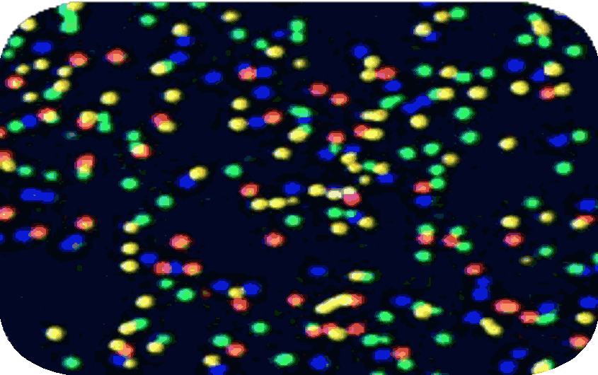
Illumina Sequence Visualization
250+ Million Clusters Per Flow Cell
20 Microns
100 Microns

Slide 34
Image Processing, Base Calling
Image processing algorithms find signals in each panel, align signals from different panels, etc.
– Machines ship with server or small cluster that does image analysis while run is happening
Sequence data after base calling much reduced in size (tens of gigabytes) => more manageable but still large amounts that add up over time
Unsustainable to keep image data; people discard the images, and just keep the sequences (fastq format).

Slide 35
Recent Illumina Innovations
Patterned flow cells (HiSeq 3000/HiSeq 4000 systems)
Allows denser cluster spacing
Avoids cluster overlap
Image analysis easier
Two-Channel SBS (NextSeq)
Two, rather than 4 colors
Leads to faster sequencing times
Synthetic Long Reads
We may discuss later, but not widely used
MiniSeq
2nd generation MiSeq – smaller, cheaper, more reads
NovaSeq – announced 2017
Up to 10 billion reads in 2 days, per flowcell (2018)
Towards $100 genome
iSeq
released last year. Benchtop ($20K) platform for 6M reads

Slide 36

How do we make an Illumina Genomic DNA library?
Double-stranded genomic DNA
Fragment (Covaris)
Polish, add dA overhang Add adaptors, size select
Sequence

Slide 37
How Much Sequence?
HiSeq 2500 can give ~250 million reads/lane of paired end 100bp reads
This is 50Gb of sequence
This is ~4,000x coverage yeast (12Mb).
This is an obvious waste of resources (it’s also ~500x
C. elegans, and ~500x D. melanogaster)
How can we sequence on a HiSeq and not waste all these resources when sequencing smaller genomes?
HiSeq 3000/HiSeq 4000
Patterned flow cells (not random clusters)
Almost twice as much data, half the time

Slide 38
What are the data?
Illumina produces data in fastq format.
@SEQ_ID
GATTTGGGGTTCAAAGCAGTATCGATCAAATAGTAAATCCATTTGTTCAACTCACAGTTT
+
!''*((((***+))%%%++)(%%%%).1***-+*''))**55CCF>>>>>>CCCCCCC65
'@’ followed by a sequence Identifier The sequence
'+’, optionally followed by a sequence Identifier The quality scores

Slide 39
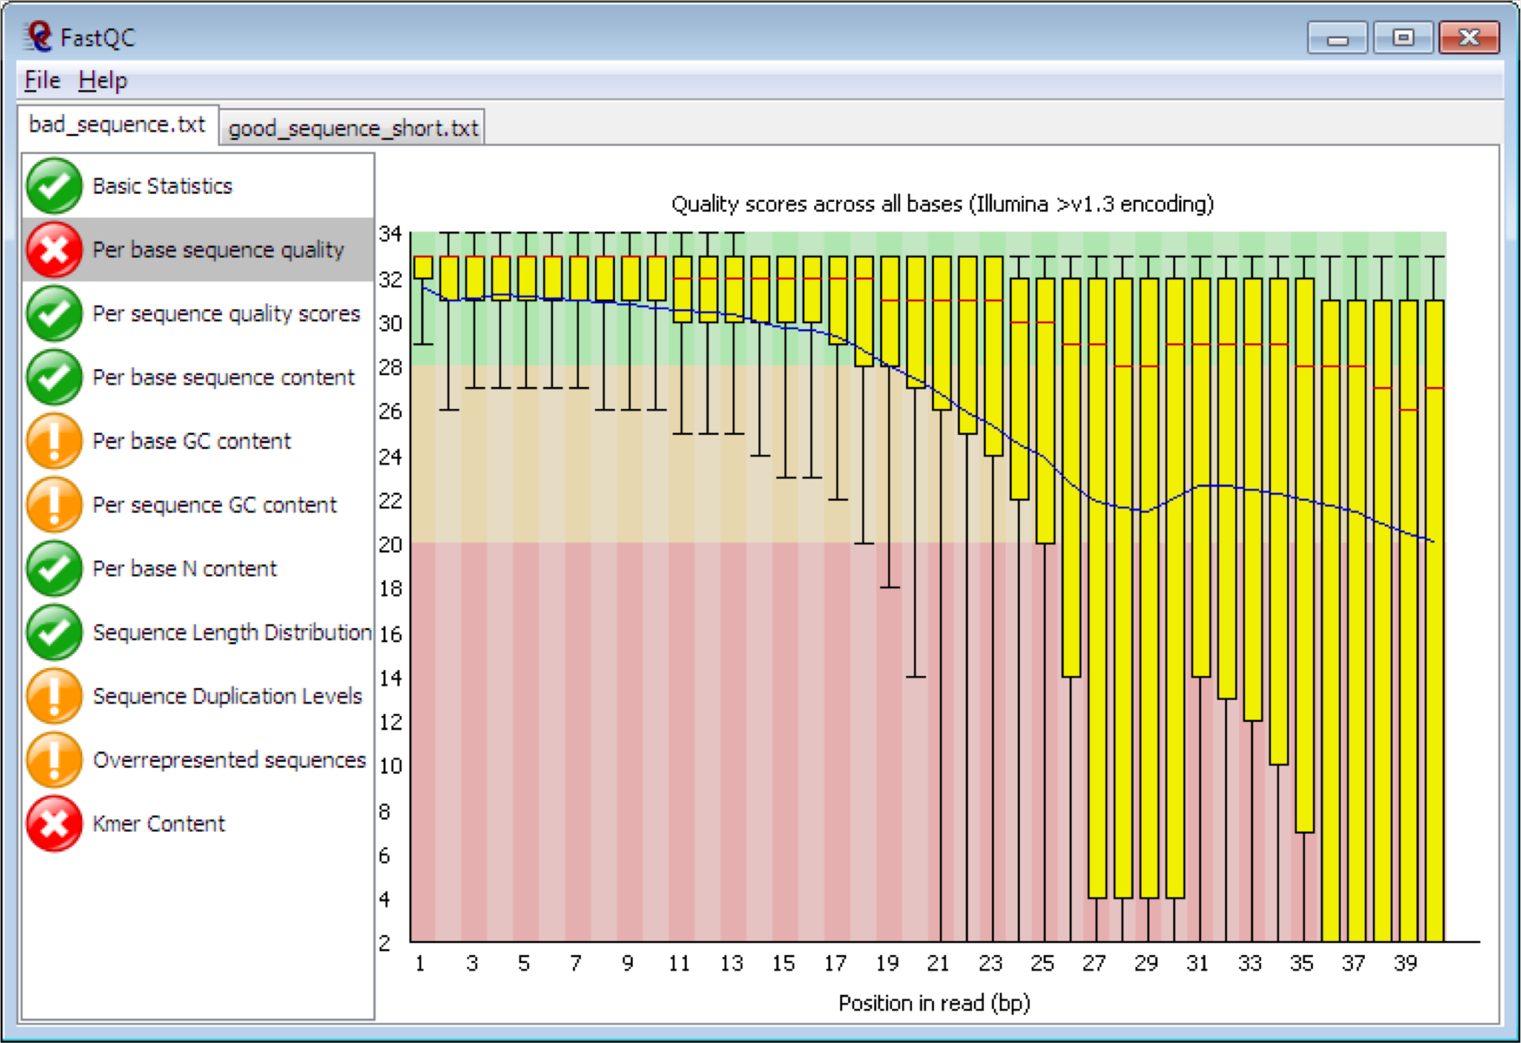
FastQC
http://www.bioinformatics.bbsrc.ac.uk/projects/fastqc/

Slide 40
De novo Assembly of Short Reads
Several methods available
Short reads require long overlaps
e.g., 33 bp reads must overlap by 20 bp
end-trimming helps, to remove low quality bases.
Most de novo short read assemblers use a k-mer hashing based approach and de Bruijn graphs.
The central challenge of genome assembly is resolving repeat regions.

Slide 41
De novo Assembly Strategies
Many, many different algorithms and open source (as well as closed source) software for short read sequence assembly.
Choice of tool depends on exactly what you are trying to assemble:
Genome size
Genome complexity
Level of polymorphism
Genome vs. transcriptome
Sequence coverage you have (more is generally better)
Paired-end vs. single end (you should really have paired-end data)
E.g.
Velvet (Zerbino and Birney, 2008)
Uses DeBruijn graph algorithm plus error correction
SGA (Simpson and Durbin, 2010)
Use String Graph – lower memory requirements, but takes longer
SOAPdenovo2 (Li et al, 2012)
Also uses DeBruijn graphs with error correction

Slide 42
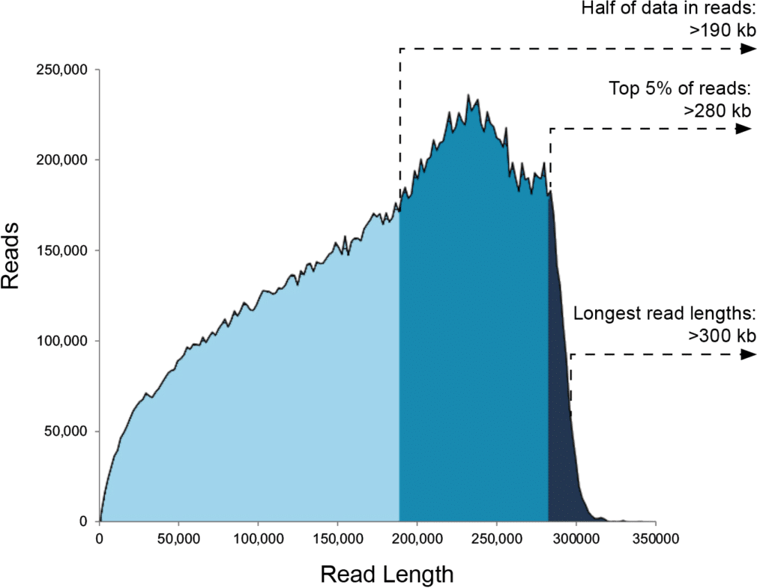
Pacific Biosciences
Single Molecule Real Time (SMRT) DNA Sequencing
Light is detected when fluorescent nucleotides are incorporated into a growing DNA strand
Half of all data in reads >45kb; can get >200kb

Slide 43
Pacific Biosciences
Single Molecule Real Time (SMRT) DNA Sequencing
Light is detected when fluorescent nucleotides are incorporated into a growing DNA strand
Half of all data in reads >45kb; can get >200kb
Accuracy now ~99% (Q20); with 40x coverage, consensus approached 99.999% accuracy (Q50)
Observation of DNA modifications
Throughput per run is low (~6 million reads), but run time is short (~6 hours)

Slide 44
Oxford Nanopore
MinION, GridION, PromethION products
DNA “sequenced” as it is dragged through a nanopore, based on change in conductance
Can also detect modified bases
High error rate (5-15%), but improving
But very long reads –>2 million bp read reported
Tons of papers/data/tools released
Nanopore is a game changer for genome assembly
Has also been reported recently to directly sequence RNA – great for seeing isoforms

Slide 45
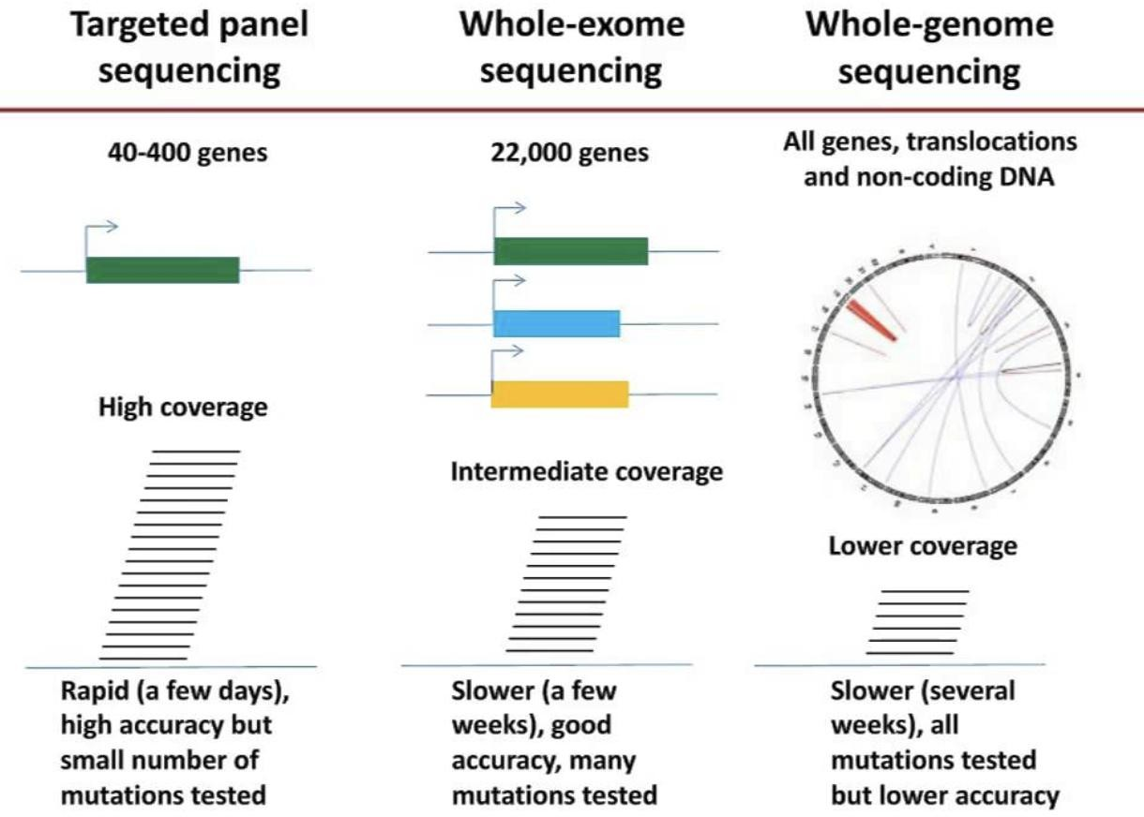
Clinical DNA sequencing
WES
WGS
Gene panel =
https://nebula.org/blog/invitae-review/

Slide 46
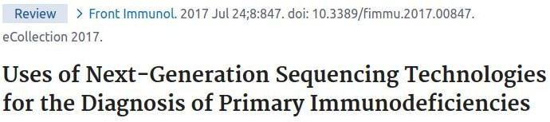
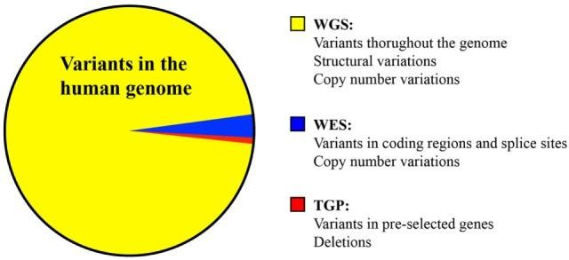
Comparison
doi: 10.3389/fimmu.2017.00847.

Slide 47
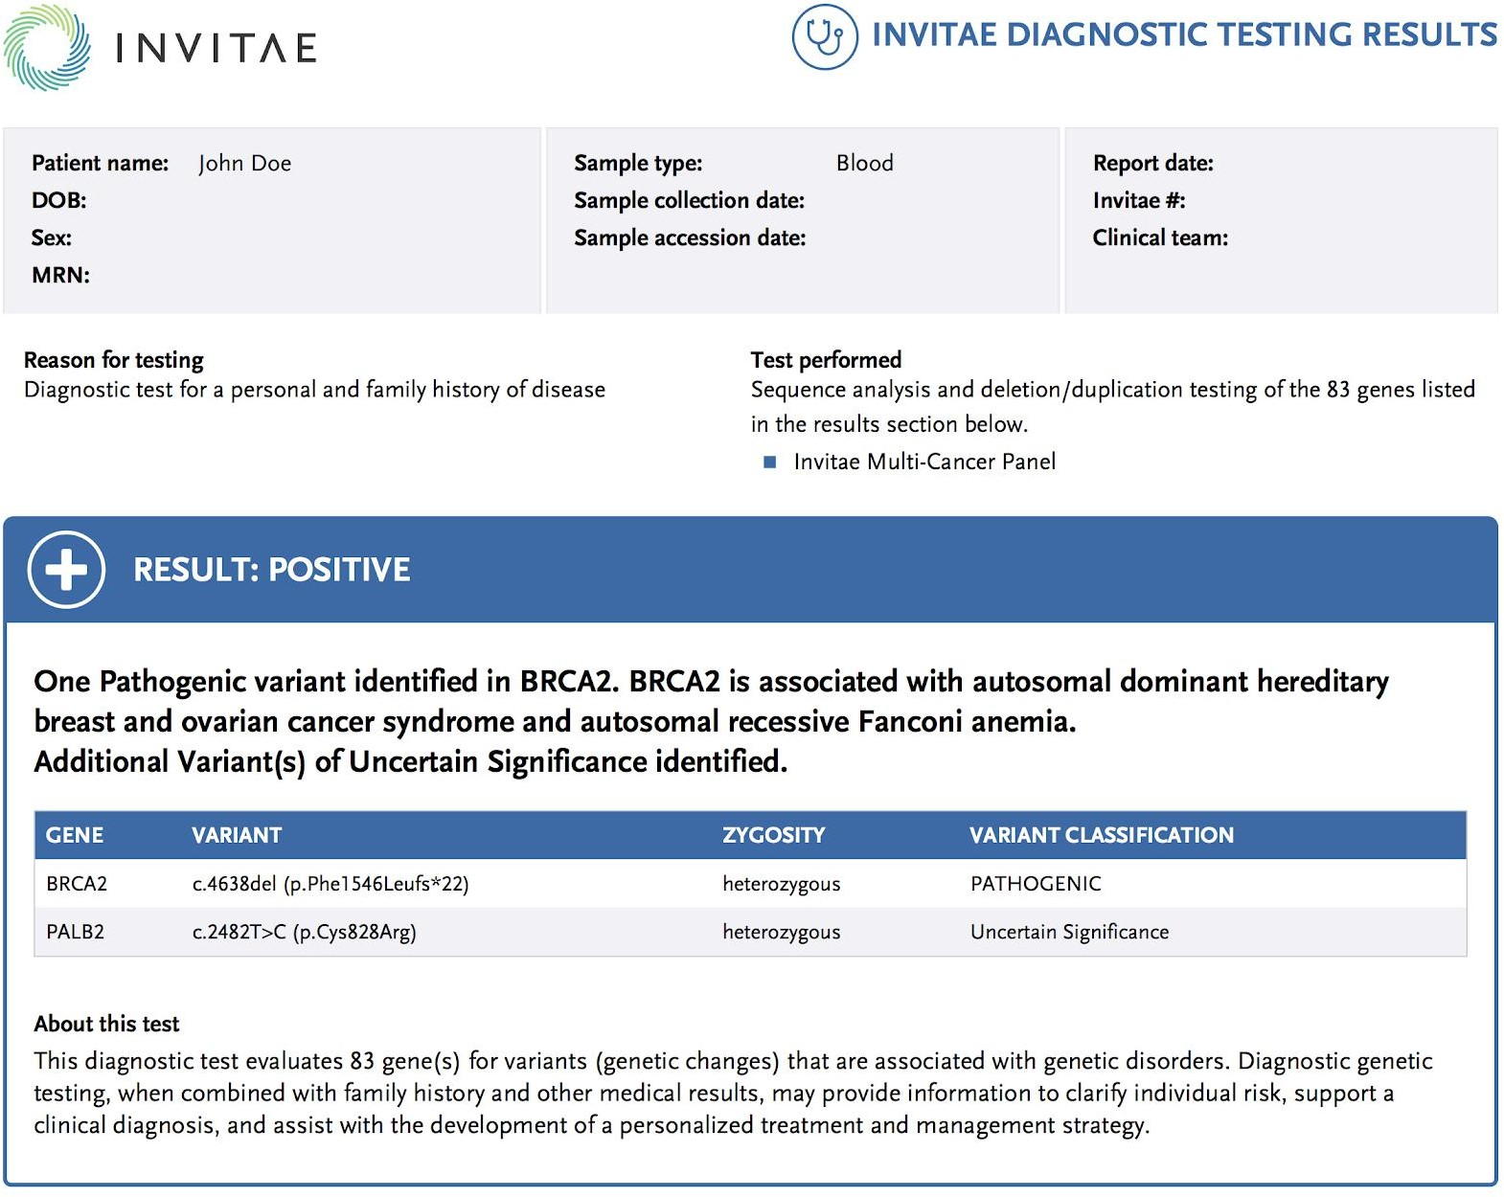
Gene panel outcome example
https://nebula.org/blog/invitae-review/

Slide 48
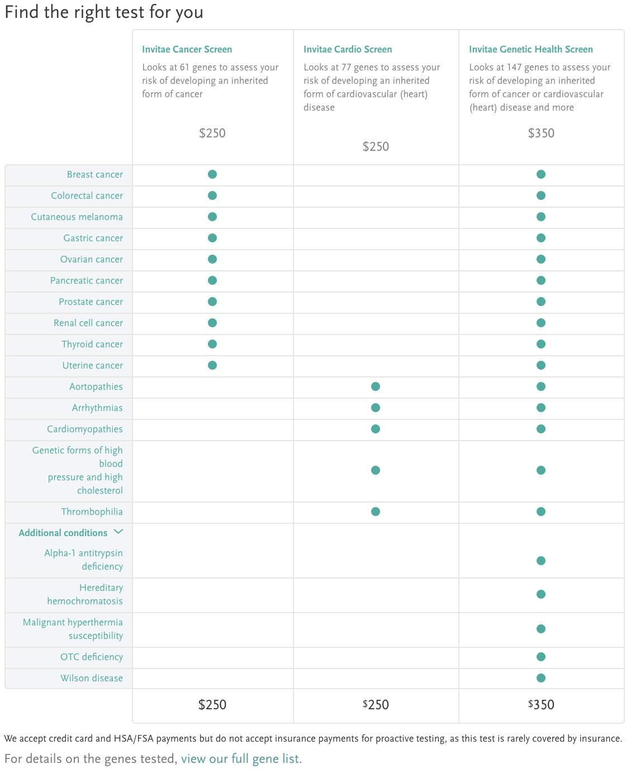
Gene panel
https://nebula.org/blog/invitae-review/

Slide 49
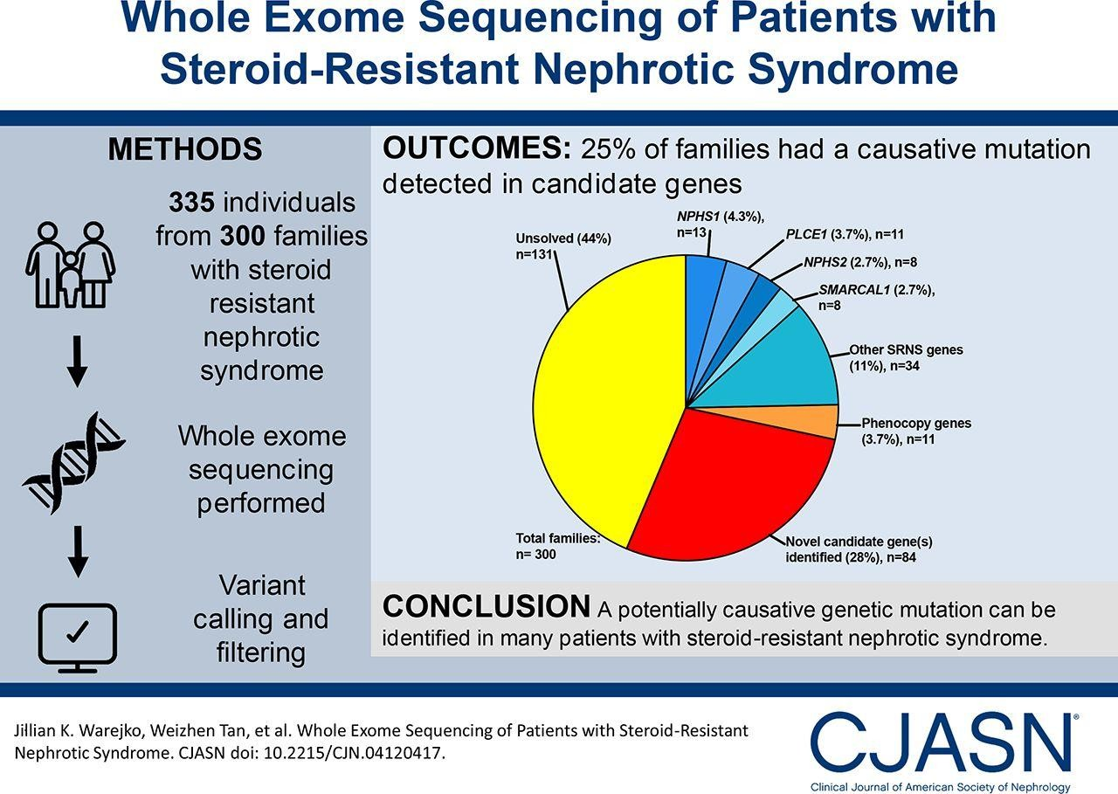

Slide 50
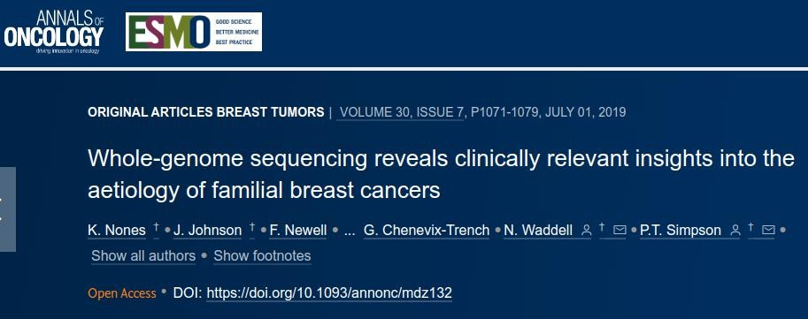
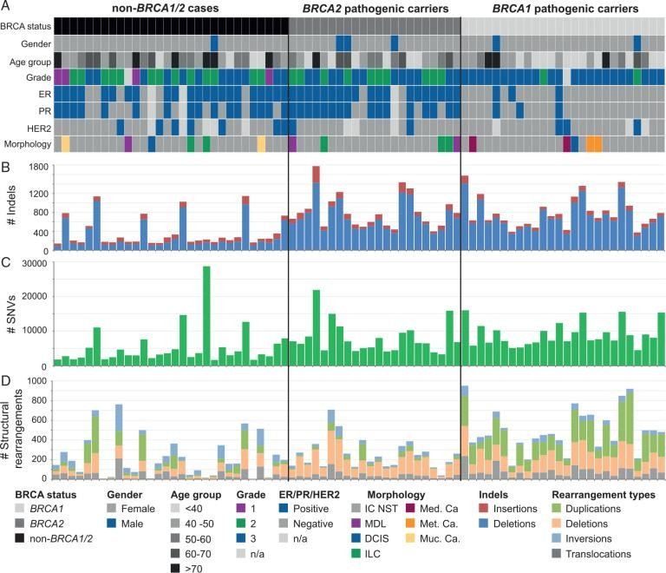
DOI:https://doi.org/10.1093/annonc/mdz132

Slide 51
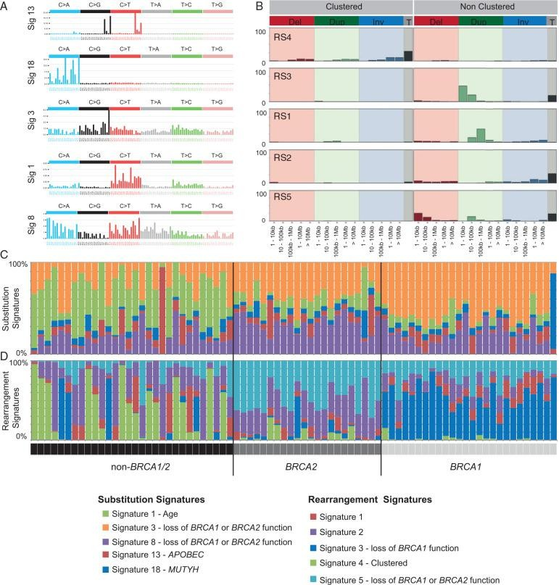
10.1093/annonc/mdz132

Slide 52
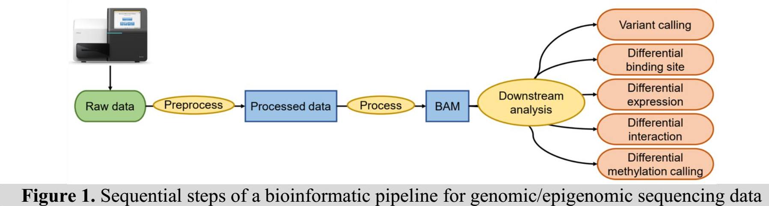

Slide 53
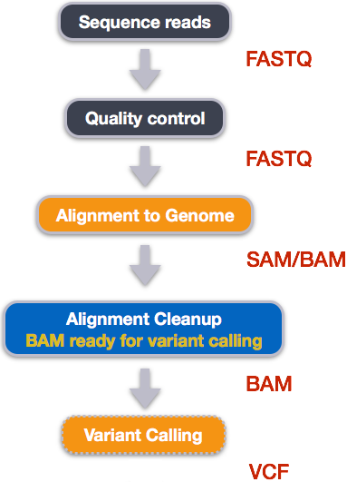
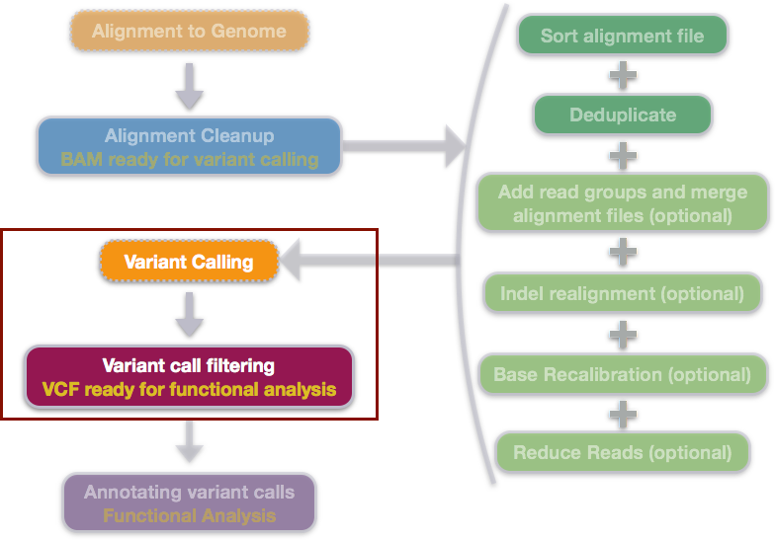
Variant calling workflow of DNA-seq
Freebayes
Simple version
Call variants with Freebayes

Slide 54
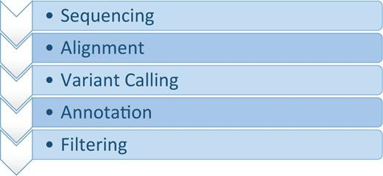
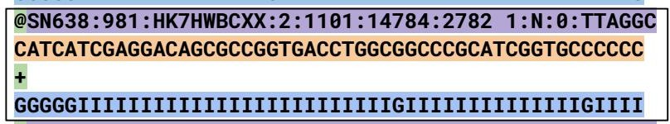

Fastq file: output from sequencing, step 1
File format in Variant calling
1)
2)
3)
4)
5)
SAM/BAM file: output from alignment, step 2
VCF file: output from variant calling, step 3
https://doi.org/10.1093/bfgp/elv054

Slide 55

BAM in IGV

Slide 56


Slide 57
Sanger sequencing?
Khi nào sử dụng Sanger sequencing (không phải microarray, không phải NGS)?
Chiều dài có thể giải?
Thời gian giải?
Độ chính xác?
Lâm sàng có chấp nhận kết quả của Sanger không và tại sao?
Sanger sequencers có IVD không?
Tiến Lê: Anh có thể cho em hỏi có trường hợp các peak có chiều cao khác nhau hoặc chồng lên nhau? mình xử lý các trường hợp này ntn. Và gtt 16s có phải phân lập ko hay có thể sử dụng mẫu môi trường Như NGS? e cảm ơn!

Slide 58
Illumina sequencers?
Chuẩn bị thư viện Library prep đòi hỏi được đào tạo mức độ nào?
Thời gian chuẩn bị thư viện Library prep bao lâu? Nó có phụ thuộc vào hệ máy không ví dụ iSeq100, MiSeq, NextSeq550 và NovaSeq?
THUY DUONG THI NGOC: ​Cho mình hỏi là đối với giải trình tự NGS trên Illunina thì khi đầu tư mua máy Illumina thì cần thêm thiết bị nào khác để cho các bước chuẩn bị mẫu không ah?
Base quality có khác nhau ở cách kênh màu 1-Dye/2-Dye/4-Dye?
Nguyên tắc của Illumina khác gì so với Sanger mà giải được rất rất nhiều trình tự so với Sanger?
Làm sao giải quyết vấn đề Optical Duplication?
Việc mua máy Illumina phải kèm theo mua những hóa chất gì và những hóa chất đó dùng cho những bước nào?
Lâm sàng có chấp nhận kết quả của Illumina không và tại sao?
Basespace có thể dùng để lưu trữ dữ liệu: được miễn phí bao nhiêu TB? Và sẽ tính tiền từ bao nhiêu TB? Và tiền lưu trữ sẽ tính như thế nào?
Và basespace phân tích bioinformatics bao gồm những pipeline nào? Miễn phí bao nhiêu, tính tiền bao nhiêu? Cách tính tiền như thế nào?
Có software nào thay cho Basespace trong lâm sàn?

Slide 59
MGI sequencers?
Chuẩn bị thư viện Library prep đòi hỏi được đào tạo mức độ nào?
Kit convert có đắc không so với việc mua trực tiếp library kit từ MGI?
Thời gian chuẩn bị thư viện MGI khoảng bao lâu?
Nguyên tắc giải trình tự của MGI là gì và có khác gì so với Sanger?
Trung bình base quality của MGI là bao nhiêu?
Việc mua máy MGI phải kèm theo mua những hóa chất gì và những hóa chất đó dùng cho những bước nào?
MGI có máy cho lâm sàng không và sự chấp nhận kết quả xét nghiệm của MGI?
MGI có cloud software như Basespace không? Nếu không thì có gì tương tự?
Có software nào dành riêng cho lâm sàn?
Nguyễn Huy Thịnh: cho mình hỏi là đối với SBS của MGI thì khi gắn nucleotide đầu tiên (vd như nucleotide A), có nguy cơ nào A này sẽ bám vào các vị trí T khác bất kì trên sợi DNA ngoài vị trí mong muốn trên primer không ạ?
Tien Vuong Quang: Hệ máy BGI cho file đầu ra theo định dạng nào thế ạ? Và em muốn hỏi thêm phần mềm phân tích thường được sử dụng là gì?
Lan Hương: Trong ứng dụng pháp y, các bộ marker nào được sử dụng trong MGI? Có phù hợp với các chuẩn CODIS của FBI hay không? MGI đã được công nhận như "chuẩn àng Sanger" chưa? Việc phân tích kết quả từ MGI có thể thực hiện trên phần mềm GeneMapper hay GeneMarker hay không? Các loại mẫu có thể thực hiện trên máy MGI? Nếu gặp mẫu hỗn hợp thì MGI có thể giải quyết được không?

Slide 60
Ion Torrent sequencers?
Chuẩn bị thư viện Library prep đòi hỏi được đào tạo mức độ nào?
Kit bắt buộc theo máy?
Thời gian chuẩn bị thư viện Ion Torrent khoảng bao lâu?
Nguyên tắc giải trình tự của Ion Torrent là gì và có khác gì so với Sanger?
Trung bình base quality của Ion Torrent là bao nhiêu?
Việc mua máy Ion Torrent phải kèm theo mua những hóa chất gì và những hóa chất đó dùng cho những bước nào?
Việc mua máy Ion Torrent phải kèm theo mua máy tính phân tích bioinformatics luôn không? Nếu không mua thì có thể tự làm phân tích bioinformatics được không?
Ion Torrent có máy cho lâm sàng không và sự chấp nhận kết quả xét nghiệm của Ion Torrent?
Ion GeneStudio có cloud software như Basespace không? Nếu không thì có gì tương tự?
Có software nào dành riêng cho lâm sàn?
Phương pháp H+ chính xác như thế nào so với MGI và Illumina? Chứng minh ntn?
duynhat le: cho e hỏi a phước là đối với hệ thống Ion Torrent mình có thể làm library riêng cho các tác nhân rồi pool mẫu vào chạy sequence nhiều tác nhân trong 1 chip dc không ạ
Nguyễn Thị Lan Hương: (hỏi Phước) Cải tiến của thế hệ S5 so với Ion Torrent đời trước là gì? (đời cũ toàn làm tay, quá cực). Nếu mua máy thì việc phân tích kết quả hãng có training cho bên mua không?
MIFOLAB (TS. Trương Huỳnh Anh Vũ): Cần phải xác nhận giá trị sử dụng phương pháp xác định target cụ thệ nào đó ạ...

Slide 61
Mix
Trần Gia Huy: Đề tài của em cần giải trình tự Whole Genome Sequencing ở thực vật (đã có draft genome trên ncbi) Xin hỏi sử dung công nghệ nào của NGS là tối ưu nhất? Xin cảm ơn.
Tô Thị Thùy Ninh: E muốn hỏi về việc Ứng dụng của NGS trong sàng lọc NIPT ạ, trong quá trình sàng lọc bất thường NST 13,18,21 thì theo e được biết Down(+) trong NIPT độ tin cậy sẽ cao hơn so với trisomy13,18(+) thì sự khác biệt ở đây là do đâu ạ?
Nhung trả lời: Hi bạn, với hệ thống ILMN thì riêng với NIPT thì server phân tích cùng pipeline phân tích đều được nghiên cứu trên lâm sàng và có IVD. Độ tin cậy của các NST ko có sự quá khác biệt đâu ạ! Ngoài ra với giải pháp mới của ILMN là VeriSeq NIPT v2 thì là phát hiện toàn bộ bất thường số lượng trên tất cả các NST và các vi mất đoạn > 7Mb ạ
Nguyễn Phương: Novaseq và máy MGI này là 2 máy giống chức năng nhau hay riêng biệt ạ
Tiến Vương Quang: Thưa thầy Lợi, với kinh nghiệm phân tích tin sinh của thầy thì thầy có thể chia sẻ những suy nghĩ, đánh giá / so sánh của thầy về chất lượng đầu ra của các hệ máy giải trình tự từ các hãng khác nhau không ạ?
Vy Nguyễn: Em muốn biết thêm về Parse Biosciences được không ạ? Coverage? Depth? Số lượng cells load được mỗi đợt chạy? Cost per cell? Nguyên lý hoạt động? Đặc trưng so với các dòng máy khác của 10X, Smart-seq2? (https://www.youtube.com/watch?v=pVyZvX8N5ww&list=PLXtgXP89Tyn_N5HAs-SWgbMKr_iOIhYrw)

Slide 62
Mix
Oanh Pham: Dạ cho em hỏi trong trường hợp nào thì kết quả NGS cần được confirm lại bằng Sanger ạ?
Quynh Nhu Nguyen: Em Xin hỏi lý thuyết cơ bản; Từ kết quả của các máy, minh sẽ có trình tự 1 sợi đơn DNA. Vậy tại sao trong file FASTA lại có read1 và read2. 2 cái read này từ đâu mà có?
Xin hỏi anh Lợi là có thể dùng NGS data từ mẫu của 2 genotype khác nhau của cùng 1 loài để làm assembly hay không?

